Slide 2
Project Title
FaceEdge: A Facial Recognition System
Project Guide
Ms. Avita Katal
Assistant Professor,
School of Computer Science

Slide 3
Team Members & Role
Mr. Ekanshu Dargan : Literature Review, Documentation, Implementation and Coding
Mr. Babanjot Singh : Literature Review, Documentation, Designing and Coding
Mr. Manik Khurana : Literature Review, Documentation, Coding, Integration and Testing
Ms. Chhavi Sharma : Literature Review, Documentation, Coding, Analysis and Testing

Slide 4
Introduction
Face (facial) recognition is the identiﬁcation of humans by the unique characteristics of their Faces.
Face recognition technology is the least intrusive and fastest bio-metric technology.
It works with the most obvious individual identiﬁer the human face. With increasing security needs and with advancement in technology extracting information has become much simpler.
Our software would use different algorithms of convolutional neural networks for facial recognition and compare the results with images stored in the database.
The basic purpose is to identify the face and retrieving information stored in database.

Slide 5
Problem Statement
India ranks third among the most attractive investment destinations for technology transactions in the world.
Technology is developing at a fast rate, yet today we use traditional system for attendance where the attendance is taken manually.
This is a time consuming and inconvenient process where the strength for attendance is too large.
This process involves a lot of human intervention with scope of errors. In order to increase security, reduce time consumption and human intervention, we develop a hassle free software that takes attendance automatically by detecting faces.

Slide 6
Motivation
Inspired by the stale state of security, the developers have been trying and failing to securely read facial traits and conclude researches with constructive results
Most of their attempts were not grounded regarding the codes and the data they shared.
In other words, the simple intuitive methods of facial recognition have enhanced attendance system by many folds.
That’s why there was a need to introduce an effective system of recording attendance using their face (something the student can never forge using photographs).

Slide 7
Objectives
To build up a facial recognition system to automatically update attendance, with the provided database of the student.

Slide 8
Software/ Hardware Requirement
Hardware:
Intel(R) Core(TM) i3-3200 CPU @ 1.5 GHz
2 GB RAM
System type is 32/64-bit Operating System
A moderately high performance GPU
Camera
Software:
Eclipse/Netbeans
Student Database
MS-Word (for documentation)

Slide 9
Literature Review
Vicky Bruce, Andy Young, Department of Psychology, University of Nottingham, Nottingham NG7 2RD, UK in a paper on Understanding face recognition [1]: They developed a theoretical model and a set of terms for understanding and discussing how we recognize familiar faces, and the relationship between recognition and other aspects of face processing.
P.J. Phillips, Hyeonjoon Moon, S.A. Rizvi, Nat. Inst. of Stand. & Technol., Gaithersburg, MD, USA [2] evaluated a large database of facial images and a testing procedure for the systems. They assessed the state of the art, identified future areas of research, and measured algorithm performance.
S. Lawrence, C.L. Giles, Ah Chung Tsoi, NEC Res. Inst., Princeton, NJ, USA, evaluated a paper on Face recognition: a convolutional neural-network approach [3], presenting quantization of the image samples into a topological space, thereby providing dimensionality reduction and invariance to minor changes in the image sample, and the convolutional neural network provides partial invariance to translation, rotation, scale, and deformation, leading to recognition of faces.

Slide 10
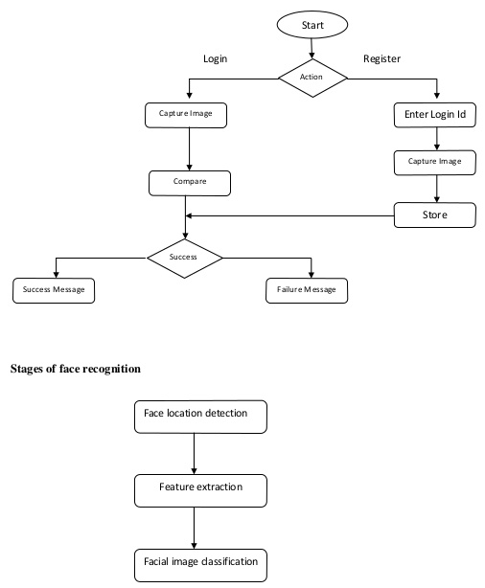
Flowchart of the System

Slide 11
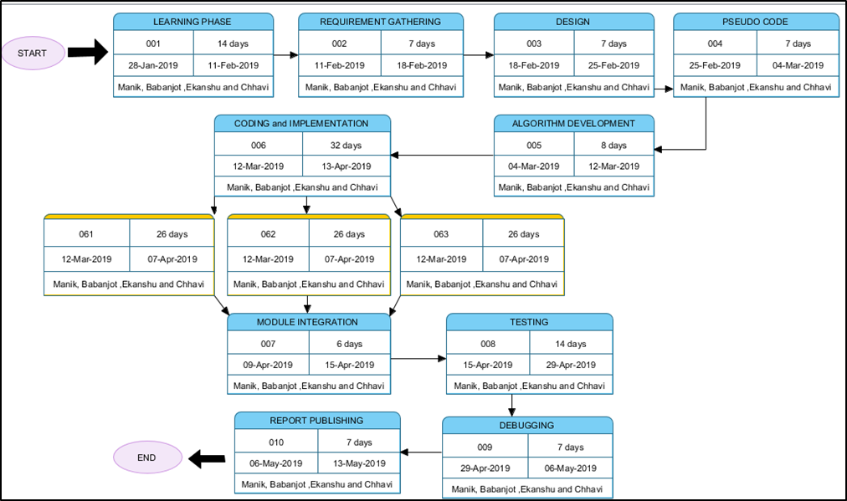
PERT Chart

Slide 12
References
[1]. Vicki Bruce, Andy Young, Understanding face recognition, https://onlinelibrary.wiley.com/doi/10.1111/j.2044-8295.1986.tb02199.x/full2. (Visit Date: 15/01/19)
[2]. P. Jonathon Phillips, Hyeonjoon Moon, Syed A. Rizvi, The FERET Evaluation Methodology for Face-Recognition Algorithms, https://www.semanticscholar.org/paper/The-FERET-Evaluation-Methodology-for-Algorithms-Phillips-Moon/0f0fcf041559703998abf310e56f8a2f90ee6f21 (Visit Date: 15/01/19)
[3]. Steve Lawrence, C. Lee Giles, Ah Chung Tsoi, Andrew D. Back, Face Recognition: A Convolutional Neural-Network Approach, http://www.cs.cmu.edu/~bhiksha/courses/deeplearning/Fall.2016/pdfs/Lawrence_et_al.pdf (Visit Date: 18/01/19)

